Slide 1



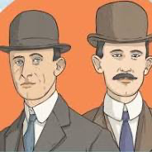
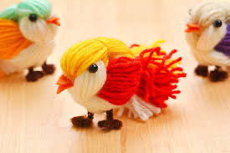


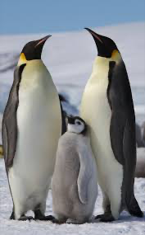


Year 1 Knowledge Organiser
FOUNDATION SUBJECTS (Spring term)
COMPUTING
In computing, topics covered include, following and creating simple instructions, correcting errors in an algorithm or program (‘debugging’), using the directional and undo keys and learning how to create and debug a simple algorithm.
JOURNEYS AND TRANSPORT
In our topic this first half term the children will be learning about:
The history of flight
The Wright Brothers
Amelia Earhart
The invention of the hot air balloon
We will be taking the children on a trip to the Brooklands Museum
ART
This term the children will be
creating colourful birds out
of wool.
The children will also be designing and creating hot air balloons
using collage and a variety of coloured paper.
After half term they will be using oil
pastels to create pictures of animals
found in the Artic and Antarctic. They will also use water colour paints to
create observational still life paintings of Spring flowers.
DESIGN TECHNOLGY
The children will be designing and building their own mode of
transport, choosing to create it out of a choice of construction
materials.
HOT AND COLD PLACES
After half term we will be covering our first geography topic, ‘Hot and Cold Places’. The children will be learning about:
Geographical locations
Physical features
Animals and habitats
What it would be like to visit
Creating and comparing
a packing list when visiting
PHSE
Dreams and Goals – creating a ‘treasure chest of success’, steps to
goals, working together to achieve goals, overcoming obstacles.
Healthy Me – what is being healthy, making healthy choices, keeping myself clean and healthy, understanding medicine safety and road safety.
FOOD TECHNOLOGY
The children are taken to the Food Technology room
to cook or bake two or three times each half term. The
first half term the children will be making yeti cup cakes, pizza pin wheels and heart biscuits. After half term they will make pasta salad and Easter nests.

