Slide 1


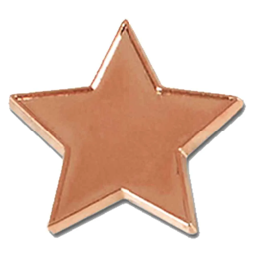

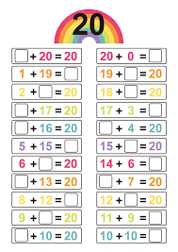
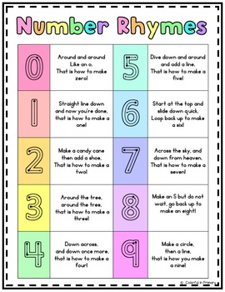
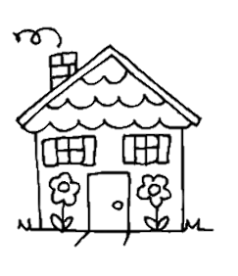
Year 1 Knowledge Organiser
MATHS (Spring term)
NUMBER BOND BADGES
In Year 1 the children work towards achieving their Bonze, Silver
and Gold number bond badges, which once awarded are worn
on their school blazer.
In the Spring Term we will begin working towards the Silver
number bond badge. The children work towards and take four
number bond written tests, answering addition and subtraction questions. Once they have passed all four tests, they receive a certificate and badge in assembly.
Please be mindful that children work at different paces to achieve these and that it is not a competition!
Key topics this term:
Place value within 20
Addition and subtraction within 20
Number bonds to 20
Place value within 50
Length, height, mass and volume
Place Value within 20 & 50
Topics covered include counting within 20, understanding place value and teen numbers, place value and understanding place value within 50, finding 1 more and 1 less, understanding and using a number line, counting by making groups of ten and partitioning into groups of tens and ones.
Number Bonds to 20
How can you learn at home?
Practice making number bonds to 20 using homemade counters, such as buttons or pieces of pasta.
Practice filling in the missing number in addition and subtraction problems, such as:
  12 + ꙱ = 20
  20 – ꙱ = 8
Addition and Subtraction
within 20
Topics covered include finding and making number bonds to 20, understanding doubles, adding by counting on, subtracting by counting back and missing number problems.
Measurement:
Topics include comparing length, weight and volume, measuring length, weight and volume using non-standard and standard units.
Practice correctly forming numerals 1 to 9 using the above rhymes as a guide. Numbers can be practiced writing in sand/glitter with your finger, or written with a pencil. The most common mistake at this age are forming numerals back to front.

