Slide 1
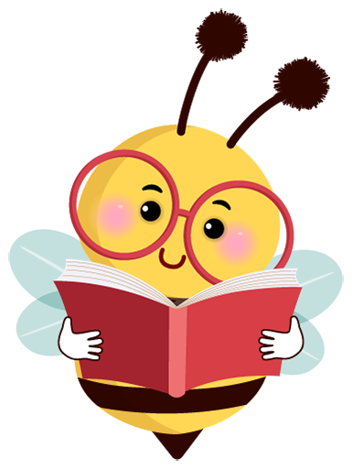
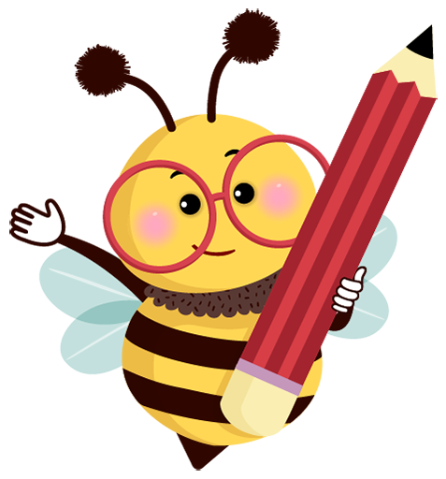

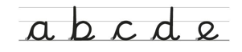
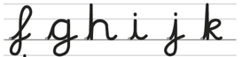

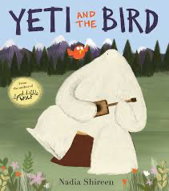
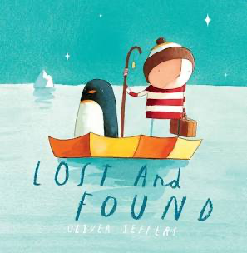
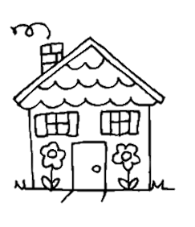
Year 1 Knowledge Organiser
ENGLISH (Spring term)
Reading and writing aren’t just part of English lessons. They are embedded across the curriculum. The children are encouraged to use their phonics skills to segment to spell and write, and to blend sounds to read, in all their subjects.
PHONICS AND READING
Children will continue to develop their phonics knowledge using Read Write
Inc., aligned with their skills and development. They are taught in small,
differentiated groups to match their level and pace.
Half-termly assessments will continue to inform progression, making sure children are always in the correct teaching group for their level. We hear the children read three times a week, one Read Write Inc. book linked to their current phonics level and two books at their current book band level.
HANDWRITING
The children will continue to learn how to form individual letters cursively, using a lead-in and lead-out line.
In the Spring term the children will begin to learn how to join letters cursively to write short words.
Key books this term:
Yeti and the Bird, by Nadia Shireen
This is a beautiful tale of forming unlikely friendships with others from different worlds. The text has strong PSHE links, exploring friendship and how we form new relationships with others. The book also has solid links to geography as different landscapes are explored. Key writing skills for the first half-term include writing in the third person and in the past tense, using adverbs to sequence sentences and using conjunctions to write compound sentences.
How can you learn at home?
Read your child’s reading book as often as possible, ideally daily.
Talk about what they have read and ask questions about the text.
Make predictions about the different texts that you read to them too.
Practise name writing and cursive letter formation in different ways.
Encourage lots of writing opportunities, such as letters and Birthday cards.
In the Spring term the children will
have a weekly spelling test.
Lost and Found, by Oliver Jeffers
There once was a boy….and one day a penguin arrives on his doorstep. The boy decides the penguin must be lost and tries to return him. This lovely tale of an unlikely friendship provides the opportunity to discuss issues around friendship as well as making links to geography. Activities to develop literacy skills include creating ‘found’ tags for other lost animals, retelling the story in their own words, writing a sequence of instructions using consistent tense and writing their own lost and found story .

